Slide 1
CHAPTER 1
ENGR 202

Slide 2
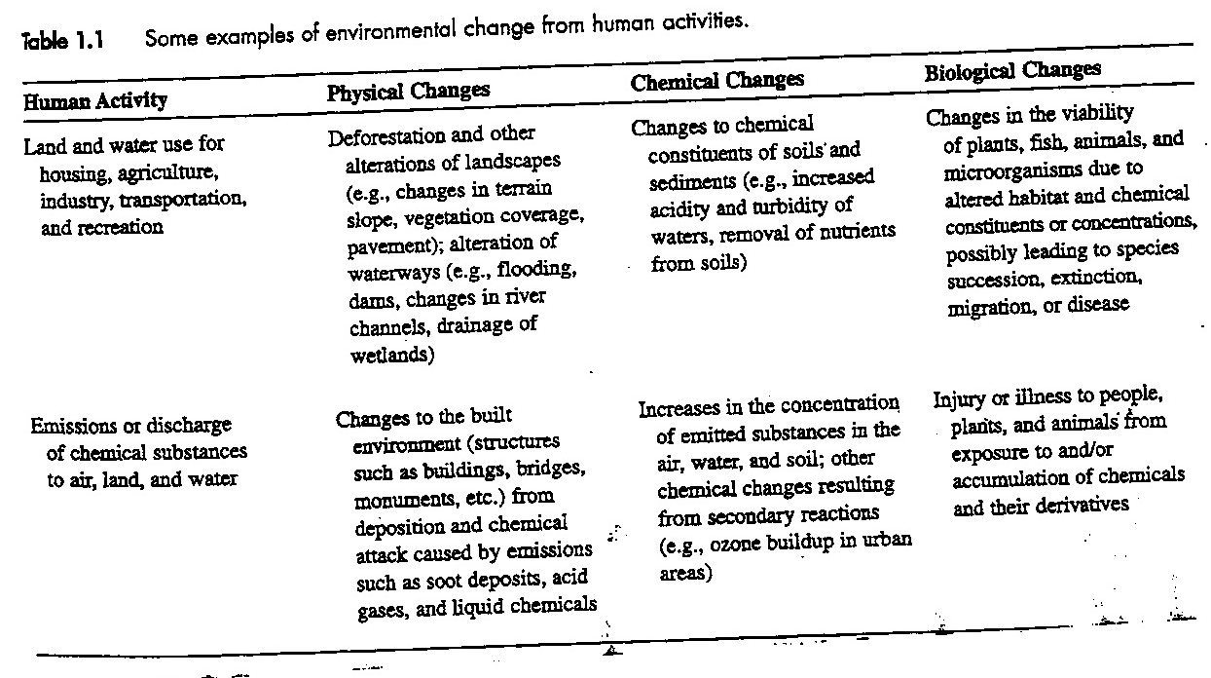

Slide 3
